Slide 1
Computer Engineering 12 Class 10
Instructor: Yuhong Liu
Office: Bannan 324 F
Email: yhliu@scu.edu
Tel: 408-551-3513

Slide 2
Hashing - DELETION
Let’s consider deleting a value from a table:
let m = 7
let h(k,i) = (k+i)%m
insert 4 <draw it>
insert 7 <draw it>
delete 7 <draw it>
insert 11 <draw it>
find 11 <draw & trace it>
find 18
del 4 <draw it>
find 11 <draw & trace it ... oops!>

Slide 3
Hashing - DELETION
What went wrong? we were fooled by the empty spot
You may be tempted to move things up ...
It’s not that simple.
How do you know whether a key is at its home location or is redirected by probing?
but what we’ll do is simpler.

Slide 4
Hashing - DELETION
We need to leave a marker when a key is deleted, so that when we search for a key, we know that we should not stop probing.
draw two parallel arrays: data & flags
flags: E = empty, F = filled, D = deleted

Slide 5
Hashing (cont’d)
Searching using flags:
E => we stop! key is not there
F => we compare
if True => stop! found it!
if False => keep going
D => keep going! <DON’T compare>

Slide 6
Hashing (cont’d)
So deletions can slow you down. If you are doing a lot of deletions, you’re better of using a different style of hash table, which we won’t present in this class
Where to insert an unfound element?
The first slot marked as empty?
The first slot marked as deleted?
Why?
1. the deleted slot is closer to the home location of that key. Reducing excessive probing cost for searching and insertion.
2. We get to reclaim a deleted slot.

Slide 7
Hashing – insertion & deletion
When inserting, we still probe as usual, but we remember the first deleted slot we saw.
If a deleted slot was found, use it over the empty slot.
Don’t forget to change the flag.

Slide 8

The add / remove operations include search.
SET | Unsorted Array | Sorted Array | Hash
Search/Find
Add
Remove

Slide 9
The add / remove operations include search.
SET | Unsorted Array | Sorted Array | Hash
Search/Find | O(n) | O(log n) | O(n) (expected O(1))
Add | O(n) | O(n) | O(n) (expected O(1))
Remove | O(n) | O(n) | O(n) (expected O(1))

Slide 10
Another ADT: BAG
A bag is an unordered collection of elements, which are not necessarily distinct.

Slide 11
BAG | Unsorted Array | Sorted Array | Hash
Search/Find
Add
Remove one
Remove all

Slide 12
BAG | Unsorted Array | Sorted Array | Hash
Search/Find | O(n) | O(log n) | O(n) (expected O(1))
Add | O(1) | O(n) | O(n) (expected O(1))
Remove one | O(n) | O(n) | O(n) (expected O(1))
Remove all | O(n) | O(n) | O(n) (expected O(1))

Slide 13
Lab 3 (Week 1)
Using hash table to build a set.

Slide 14
Start
Today: Ch. 3+4
You are responsible for section 3.1
You are responsible for section 4.1
In other words, just the concepts of stacks and queues.

Slide 15
List
A list is an ordered collection of items, which are not necessarily distinct. Ordered does not necessarily mean sorted, rather that there is a 1st, 2nd, ... ith, .. nth etc.
Two important types of lists are:
1.stacks
2.queues
We can look up items by position (indexing) on a list. Sometimes also by name/id/key, but position is usually more important.

Slide 16
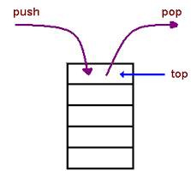
Stack - Concept
Concept:
A stack is a linear list in which all additions and deletions are restricted to one end, called the top.
Feature:
A stack obeys last-in/first-out order (LIFO). The last item inserted into the stack is always the first to be removed.

Slide 17
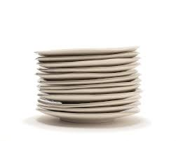

Stack - Example
We can think of a stack where we need to remember a bunch of things and always go back to the most recent thing.
Examples:
stack of plates
back button on browser
undo button

Slide 18
Stack – Implementation through Array
Nomenclature
insert = push
remove/delete = pop
Let’s consider implementing a stack using an array.

Slide 19
Stack – Implementation through Array
Assume that we use the end of the array for push and pop. If there are n things in an array, the next available slot is slot ....?
Push
assert(n<m);
a[n] = x;
n++;

Slide 20
Stack – Implementation through Array
Pop
assert(n>0);
x = a[n-1];
n--;
return x;
Big-O?
O(1) for both push and pop

Slide 21
A Question
How would you feel if office hours were a stack ?
It’s unfair!

Slide 22
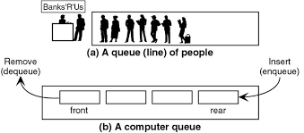
Queue - Concept
Concept
A queue is a linear list in which data can only be inserted at one end, called the rear, and deleted from the other end, called the front.
Feature
A queue obeys first-in/first-out order (FIFO). The first item inserted is always the first to be removed.

Slide 23
Queue – More Notes
In a queue we always remove the oldest item in the list
they’re often used to ensure fairness
We can think of a queue as a list in which insertions and deletions/removals happen at opposite ends.

Slide 24
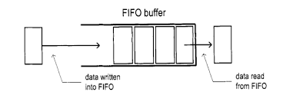
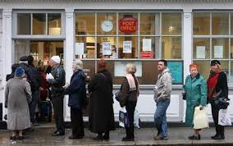
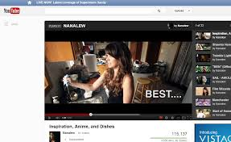
Queue - Examples
a buffer
netflix queue / youtube or itunes playlist
standing in line

Slide 25
Exercise
Indicate whether a stack or a queue is more appropriate to represent the call and return sequence of functions in a running computer program?

Slide 26
Queue – Implementation through Array (Method I)
Nomenclature:
insertion = enqueue
deletion = dequeue
Let’s consider implementing a queue through an array.
Add at the end, remove from the front (always keep the front of the queue located at index 0)
What’s the bigO for insertion? Deletion?
Insertion – O(1)
Deletion – O(n) (including shifting)

Slide 27
Queue – Implementation through Array (Method II)
Can we make both of them O(1)?
There is no reason to force the front of the queue always to be in items[0], we can let it "move up" as items are dequeued.
Use a pointer “first”

Slide 28
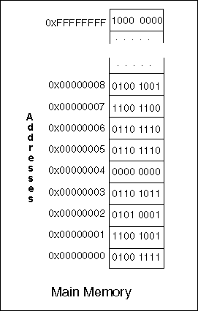
Recall the Meaning of a Pointer
Memory Address (&)
A pointer variable: e.g. ptr is designed to hold memory addresses, or in other words, it holds the location of some other piece of data.
ptr = 0x0000008
*ptr = 0100 1001

Slide 29
Queue – Implementation through Array (Method II) Example
Example: we use “first” as a pointer, count as an int
int * first; int count
draw an array with m=4, count=0, “first” points to nothing.
enq 3 <queue is often abbreviated “q”>
count = ?, first = ?
enq 7 <draw array> count = ?, first = ?
enq 4 <draw array> count = ?, first =?
Notes:
Enq 3, count = 1, first = 0
Enq 7, count = 2, first = 0
Enq 4, count = 3, first = 0

Slide 30
Queue – Implementation through Array (Method II) Example
Example (cont’d):
deq <you have no choice what gets pop’d or deq’d>
3 comes out. count=?, first=?
enq 7 <draw array> count=?, first=?
deq <draw array> count=?, first=?
Notes:
Deq count = 2, first = 1
Enq 7, count = 3, first = 1
Deq, count = 2, first = 2.

Slide 31
Queue – Implementation through Array (Method II) Example
Example (cont’d):
Enq 1? What is the problem?
There is no room at the end, but …
How to use it?
bend the array into a circle, so we’d add 1 at location 0
how to treat the indices of the queue as a circle? .... have used such a function?
YES, mod
so we just have to do all our arithmetic modulo the size of the array
Notes:
There’s no room, at the end.
But there is at the front

Slide 32
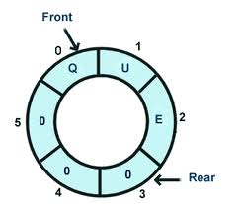
Queue – Implementation through Array (Method II) Example
Let’s treat the indices as if the array was circular. This is known as a circular buffer.
To accomplish this, we’ll do all our arithmetic modulo the size of the array.
Three variables:
length = length of the buffer
count = # of things in the buffer
first = location of the first item

Slide 33
Queue – Implementation through Array (Method II) Code
enq
assert(count < length)
a[(count+first) % length] = x
count++;

Slide 34
Queue – Implementation through Array (Method II) Code
deq
assert(count > 0);
x = a[first];
first = (first+1)%length;
count--;
return x;

Slide 35
Real Life Examples
Are there any examples of using Queues and Stacks in practice?
Robot maze solver …
https://www.youtube.com/watch?v=uPyd8m3QkN0
Use a stack or a queue to implement this?

